Slide 1
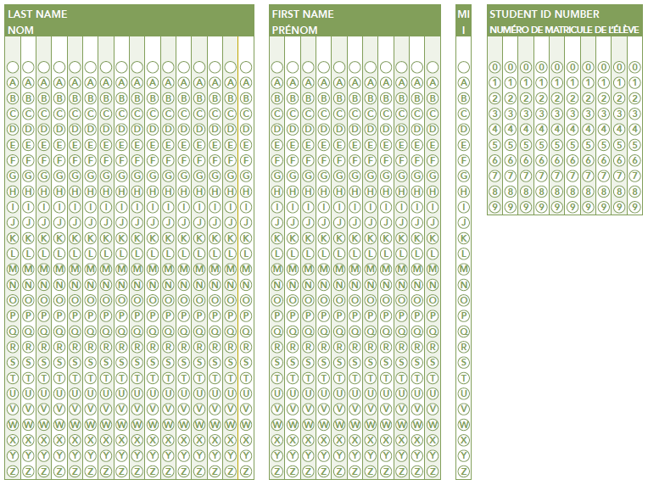
Provincial Assessment Program Overview of Results 2018-19
Appendix D
Anglophone Sector
Assessment, Analysis & Design Services Branch, November 6, 2019

Slide 2
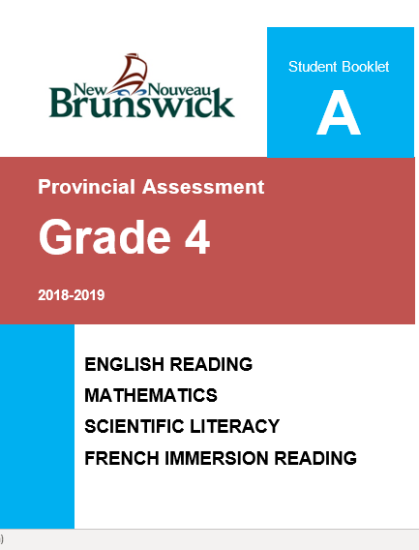
Presentation Overview
Updates
Early Years Evaluation
English Reading
French Reading
French Oral Proficiency
Mathematics
Scientific Literacy
Context:
Student perceptions

Slide 3
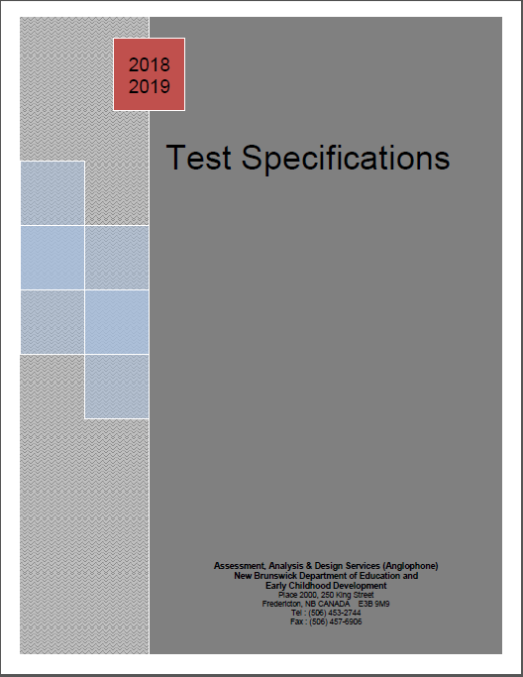
Updates
Common statistical methodology was adopted across sectors for consistency, begun last year with Grade 10 assessments, this year applied to Grade 4 & 6
This means:
Better equating of assessment
difficulty level from year to year
Comparative data will be available
for all assessments going forward

Slide 4
Updates continued
Grade 4 assessments were administered for the first time, baseline was established using the new analysis methodology
Grade 6 assessments were reviewed to better align with achievement at other grade levels/PCAP/PISA.
Also, the percentage correct required to be considered as performing at Appropriate Achievement or above (i.e., “successful”) was changed from 60% to 55%. This is consistent with all Francophone assessments.
AND
The new statistical methodology was applied.

Slide 5
Updates continued
IMPACT of Grade 6 changes:
2018-19 is the new baseline; comparison with the previous three years is not appropriate
Despite parameter changes, an attempt was made to apply the former analysis methodology to this year’s data.
It appears that mathematics and science results improved substantially, PIF reading declined, and English and Early and Late FI reading success rates would have remained similar to 2017-18.

Slide 6
Updates continued
“Did not Write” percentage is no longer included in calculating the % successful for any of the assessments (since we do not know how students would have performed)
“Exempt” continues to be counted as “Below Appropriate”
Notes:
%Successful” = Appropriate + Strong Achievement
Province = Anglophone sector unless otherwise stated

Slide 7
Assessment | Results First Published | Number of Years of Comparable Data |  | Results available at
Grade 2 English Reading | 2002-03 | 9 | New baseline 2009-10 due to elimination of FI Grade 1 Discontinued 2018-19 | Student-level
Grade 4 Provincial Assessment English Reading, Math, Science, FI Reading | 2018-19 | 1 | New assessments | School-level (matrix sample)
Grade 6 Provincial Assessment English Reading, Math, Science FI Reading, Post Intensive French Reading | 2015-16 2017-18 | 1 | New baseline 2018-19 final adjustment of new assessments | School-level (matrix sample)
Grade 10 Provincial Assessment Math, Science, French Immersion Reading Post Intensive French Reading | 2017-18 2018-19 | 2 | No change in methodology | School-level (matrix sample)
Grade 9 English Language Proficiency Assessment | 2005-06 | 13 | No change in methodology | Student-level (graduation requirement)
Grade 6 FSL Oral Proficiency Interviews conducted biennially | 2016-17 | 2 | No change in methodology | District-level (10% sample)
Grade 10 FSL Oral Proficiency Interviews conducted biennially | 2003-04 | 8 | No change in methodology | District-level (10% sample)
Grade 12 FSL Oral Proficiency Interviews | 1977-78 | 5 | New baseline 2014-15 due to program and eligibility changes | Student-level
Notes:
Available assessment data
We also have Contextual Report data for Grades 4, 6, & 10 (i.e., several student survey questions that are completed at the same time as the assessments so the assessment results can be analyzed in relation to the student perceptions).

Slide 8
EYE-DA assesses five developmental areas associated with readiness to learn at school:
Developmental Area | Examples of child’s ability in each developmental area:
Awareness of Self & Environment | notice, think and talk about their world (e.g., identify: opposites, characteristics of common animals, colours, …) understand and use home and community experiences (e.g., A police officer keeps you safe)
Cognitive Skills | name letters and sounds recognize rhyme name numbers and count sets of objects recognize same and different
Language and Communication | listen and understand instructions, discussions, and stories use full sentences (i.e., five to seven words) to explain their ideas talk so people can easily understand
Fine Motor Skills | use crayons and pencils, cut, and handle small objects (e.g., sort and rearrange pebbles)
Gross Motor Skills | balance, hop on one foot, and jump
Notes:
EYE-DA = Early Years Evaluation-Direct Assessment
This screener is administered the fall prior to Kindergarten entry to identify children who have delays in any of the domains. This provides time for interventions and planning before children begin school.

Slide 9
EYE-DA Over Time: Language & Communication Domain
Notes:
Participation in the EYE-DA has been 86% or better since its introduction.

Slide 10
EYE-DA Over Time: District and Province

Slide 11
English Reading Overview
 | Success Rates
 | 2017-2018 | 2018-2019
Grade 2 | 71% | -
Grade 4 | - | 67.2%
Grade 4 PIRLS | NB Anglophone on par with Canada 535 - 543
Grade 6 | 61.1% | 71.7%
Grade 8 PCAP | NB tied for 7th (last) place with SK, NF, MB
Grade 9 ELPA | 80.6% | 73.6%
PISA (15 year-olds) | NB Ranking 7th (Anglophone is higher)
PIRLS 2016 = Progress in International Reading Literacy Study
PCAP 2016 = Pan-Canadian Assessment Program
PISA 2015 = Program for International Student Assessment

Slide 12
Grade 4, 6 and 9: English Reading 2018-19 % Successful by District and Grade level
Notes:
Reminder: % Successful = % Appropriate + % Strong

Slide 13
Grade 4: English Reading 2018-19 % of Students by Achievement Level

Slide 14
Grade 6 English Reading 2018-19 % of Students by Achievement Level

Slide 15
Grade 9 English Language Proficiency 2018-19 % of Students by Achievement Level

Slide 16
Grade 9 ELPA 2018-19 % Successful Students by Program Over Time
(n) refers to the number of students included in each district
Notes:
Results declined substantially across programs this past year.
ELPA = English Language Proficiency Assessment
Results include only Grade 9 students attempting the assessment for the first time.
Students who Did Not Write or were Exempt are not included in the calculation of results.
Successful = % Appropriate + % Strong

Slide 17
Grade 9 ELPA – 2018-2019 % Successful Students by District Over Time
Notes:
The decline was also consistent across districts.

Slide 18
Grade 8 PCAP Reading
Notes:
Results are provided in the form of average score with a mean of 500 (on left) and by performance level (on right). Performance level is only available in the years where Reading is the major domain.
Pan-Canadian Assessment Program (PCAP)
All Canadian provinces participate
Is administered every 3 years

Slide 19
French Second Language

Slide 20
French Second Language Reading Assessment % Successful by District by Grade level
Note: All students writing these assessments began FI in Grade 3.
Notes:
FI = French Immersion

Slide 21
French Second Language Reading Assessment % Successful by District by Grade level
Note: All students writing these assessments began FI in Grade 6.

Slide 22
French Second Language Reading Assessment % Successful by District by Grade level
Note: All students writing these assessments participated in the Grade 5 Intensive French Program.

Slide 23
FSL Grade 10 Reading Assessment Early French Immersion
Note:
All students writing this assessment began FI in Grade 3.
2017-18 2018-19
Notes:
Grade 10 is the only assessment for which we are able to make valid comparisons across two years … so far!

Slide 24
FSL Grade 10 Reading Assessment Late French Immersion
Note:
All students writing this assessment began FI in Grade 6.
Notes:
Grade 10 is the only assessment for which we are able to make valid comparisons across two years … so far!

Slide 25
NB Second Language Oral Proficiency Scale Performance Description for Intermediate Level (B1.1)
The student is able to satisfy routine social demands and limited requirements in school/work settings with a speaking vocabulary sufficient for simple conversation, with some paraphrasing.
The student can:
provide information and give explanations with some degree of accuracy;
handle most common social situations, including introductions and casual conversations about events in school and community;
provide autobiographical information in some detail;
give directions from one place to another; and
give accurate instructions in a field of personal expertise.
Notes:
We have chosen the “Intermediate” level of proficiency for comparing the success of the three FSL programs offered in NB. This level can be considered “conversational French”.

Slide 26
French Second Language Oral Proficiency % Intermediate and Above by District by Grade level – all Programs
Students assessed in Grade 6 and 10 began FI in Grade 3
Students assessed in Grade 12 began FI in Grade 1
Note: the Grade 10 assessment was administered in 2017-18
Notes:
Administration of the Grade 6 and 10 Oral Proficiency Assessments alternate, so the Grade 10 results are from the 2017-18 year. They are included in the presentation to provide a more complete picture of FSL results.

Slide 27
Grade 6 French Second Language Oral Proficiency
Unrateable Novice Basic Basic Intermediate Intermediate Advanced Advanced Superior
Plus Plus Plus
(n) refers to the number of students assessed
Notes:
594 students were assessed in 2018-19.
This slide illustrates the difference between the three FSL programs when students are in Grade 6.
Late FI students have only been in the immersion environment for a few months.
PIF students benefitted from the Intensive French program in Grade 5.
The next two slides show the distribution of proficiency levels as students advance through their programs in Grades 10 and 12 (these are different cohorts, of course).

Slide 28
Grade 12 French Second Language Oral Proficiency
All students assessed in Grade 12 began FI in Grade 1
Notes:
Note: in 2014-2015 school year, participation was mandatory for Grade 12 Early and Late entry French Immersion students but not for PIF.
French Immersion students, both early and late entry are defined as those who adhere to Policy 309. Students must have taken 25% of courses in French in Grade 11 and/or Grade 12.
In Year 2015-16, participation was mandatory for Grade 12 all three programs.
Reason being we have exhibited the data for PIF beginning 2015-16

Slide 29
Grade 12 French Second Language Oral Proficiency Post Intensive French - % attaining Intermediate and Above
Notes:
Promising results for the IF/PIF program. Results have improved in all districts.

Slide 30
Grade 12 French Second Language Oral Proficiency
Notes:
2014-15 – Assessment in EFI & LFI was Mandatory but PIF was still optional

Slide 31
Mathematics

Slide 32
Mathematics Overview
 | Success Rates
 | 2017-2018 | 2018-2019
Grade 4 | - | 62.3%
Grade 6 | 37.1% | 57.8%
Grade 8 PCAP | NB tied for 4th place with PEI, NS, BC
Grade 10 | 64.5% | 62.8%
PISA (15 year-olds) | NB Ranking 19th (Anglophone is lower)
PCAP 2016 = Pan-Canadian Assessment Program
PISA 2015 = Program for International Student Assessment

Slide 33
Mathematics – 2018-2019 % Successful by District by Grade level

Slide 34
Grade 4: Mathematics 2018-19 % of Students by Achievement Level

Slide 35
Grade 6 Mathematics – 2018-2019 % of Students by Achievement Level

Slide 36
Grade 10 Mathematics
Percentage of Successful Students by District
Notes:
Grade 10 is the only assessment for which we are able to make valid comparisons across two years … so far!

Slide 37
Grade 8 PCAP Mathematics

Slide 38
Scientific Literacy

Slide 39
Scientific Literacy Overview
 | Success Rates
 | 2017-2018 | 2018-2019
Grade 4 | - | 61.0%
Grade 6 | 35.1% | 55.9%
Grade 8 PCAP | NB tied for 8th place with NS, SK, MB
Grade 10 | 64.7% | 65.4%
PISA (15 year-olds) | NB Ranking 10th (Anglo and Franco are the same)
PCAP 2016 = Pan-Canadian Assessment Program
PISA 2015 = Program for International Student Assessment

Slide 40
Scientific Literacy 2018-19 % Successful by District by Grade level

Slide 41
Grade 4: Scientific Literacy 2018-19 % of Students by Achievement Level

Slide 42
Grade 6 Scientific Literacy 2018-19 % of Students by Achievement Level

Slide 43
Grade 10 Scientific Literacy
Notes:
Grade 10 is the only assessment for which we are able to make valid comparisons across two years … so far!

Slide 44
Grade 8 PCAP Science

Slide 45
Student contextual information

Slide 46
Student Perception Survey
By Grade 12 …
56% of students report having a positive sense of belonging
57% value school outcomes
36% are interested and motivated
nearly one third report being absent from school without permission in the four weeks preceding the survey
In Grades 6 to 12, on average 30% of students report moderate or high levels of anxiety or depression
Source: OurSCHOOL Student Survey, 2018-19

Slide 47
Assessment Program Contextual Questions
18 survey questions are included in the assessment booklets for Grades 4, 6, & 10
These were adapted from the PISA contextual survey, selected for their relatively strong correlation with math performance
They cover 4 domains:
Student self-perception (e.g., I understand things quickly.)
Learning environment (e.g., The teacher tells us at the beginning of the lesson what we should know by the end of the lesson.)
Student personal characteristics (e.g., number of times late for school)
Socio-economic status (e.g., number of books in home)

Slide 48
Assessment Program Contextual Questions Highest Correlations with Grade 10 Math Achievement
Q503 - I like to solve hard problems (+0.491)
Q501 - I understand things quickly (+0.465)
Q520 - Do the adults you live with have a university degree? (+0.122)
Q515 - How many books in your home? (+0.273)
Q502 - I can easily make connections between facts (+0.434)
Q513 - Teacher asks us to explain our steps for answers/what info. we used (+0.133)
Q514 - In the last two weeks, how many times were you late for school? (+0.149)
Q517 - How many computers in your home? (+0.206)
All other items have either negative or no correlation.
Source: NB Provincial Assessment Program Grade 10 Contextual Survey, 2018-19
Notes:
Although the correlations are not very strong, there are large differences in the survey responses of students who scored in the top and bottom quartiles on the assessment … (next slides)

Slide 49
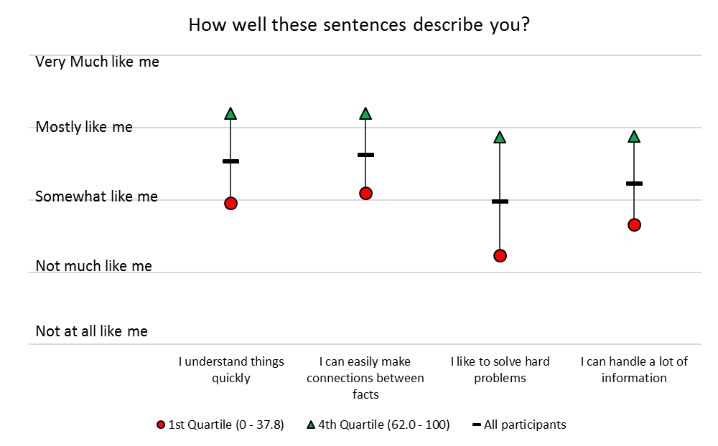
Grade 10 Student Perceptions
Notes:
How to interpret this graph:
Black bar = the average rating of all students on the 5-point scale
We can see, on average, fewer students agreed with the statement “I like to solve hard problems”.
Red dot = the average rating on the survey item of students with the lowest 25% math scores
Green arrow = the average rating on the survey item of students with the highest 25% math scores
We can see that students with the lowest math scores also have the lowest self-ratings.
The biggest difference between the low and high performers is on their self-rating of: “I like to solve hard problems”.
Source: Assessment Contextual Student Survey Grade 10, 2018-19

Slide 50
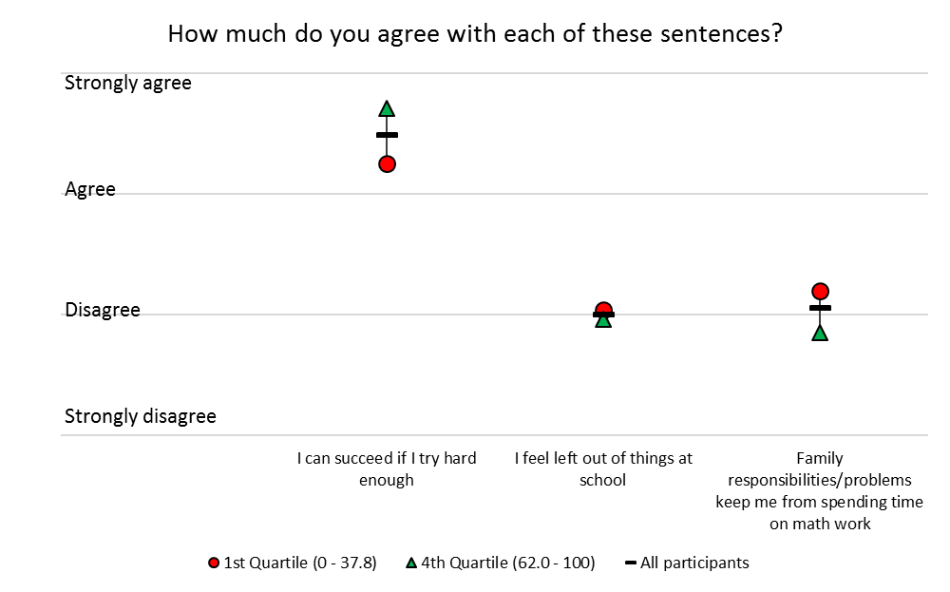
Grade 10 Student Perceptions
Notes:
There is no difference in ratings of the highest and lowest performers on “I feel left out of things at school” and family responsibilities.
Source: NB Assessment Program Contextual Student Survey Grade 10, 2018-19

Slide 51
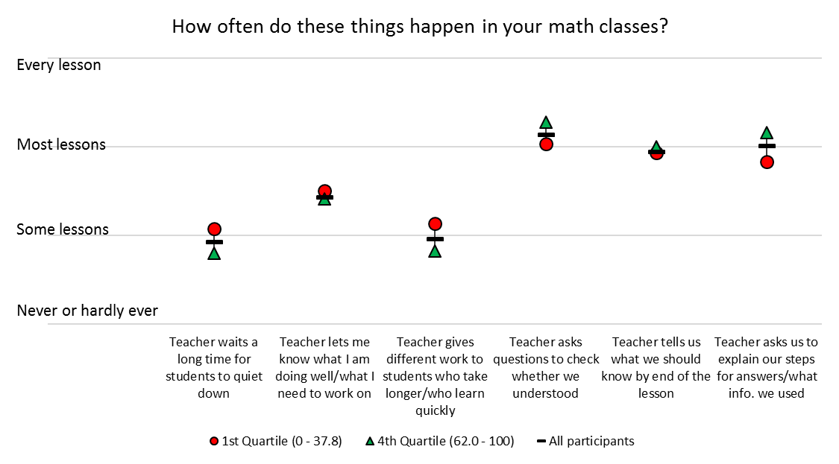
Grade 10 Student Perceptions
Notes:
Likewise, high and low performing students’ judgements of the learning environment differed little.
Source: NB Assessment Program Contextual Student Survey Grade 10, 2018-19

Slide 52
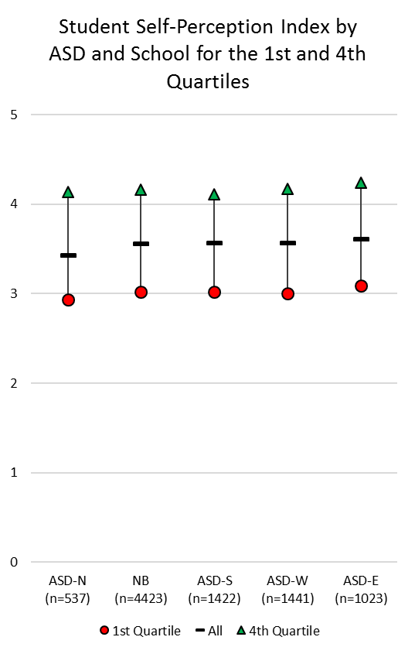
Grade 10 Student Perceptions
Notes:
Looking at the Student Self-Perception domain, we can see that the large difference in ratings of the lowest and highest math performers is consistent across districts.
Source: NB Assessment Program Contextual Student Survey Grade 10, 2018-19

Slide 53
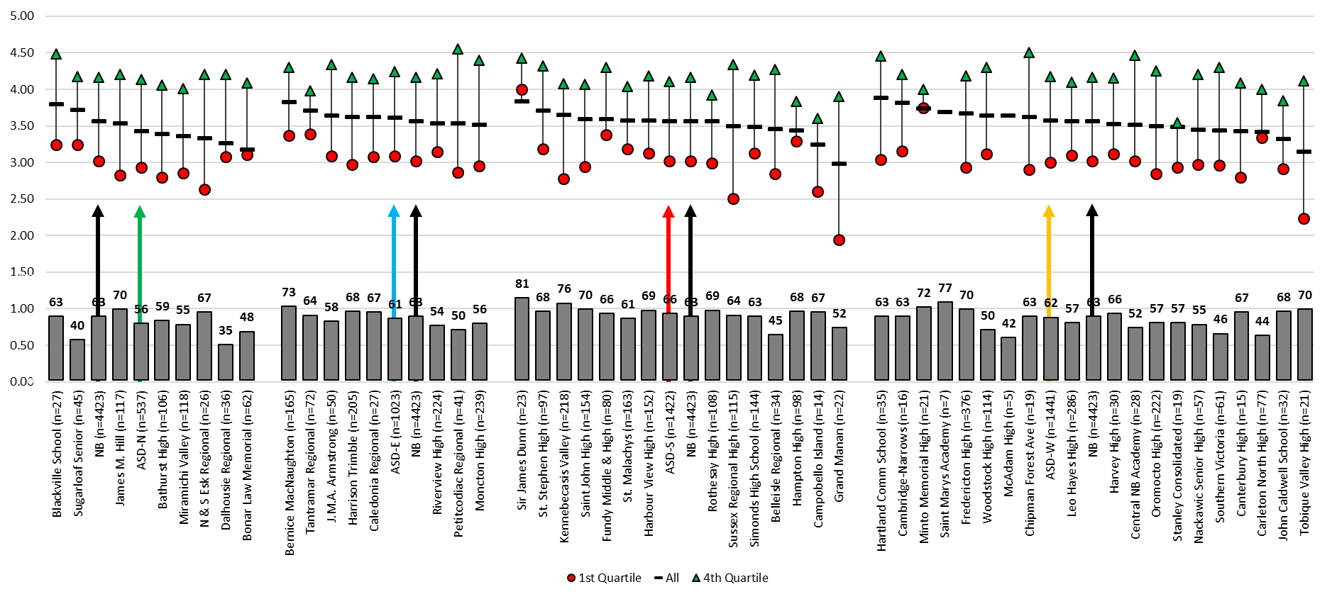
Grade 10 Student Perceptions
Notes:
On this graph:
Black bar = the average rating of all students in the school
Red dot & green arrow = the lowest and highest performers in relation to the provincial average (not just the quartiles in the particular school)
Grey bar = % of students at Appropriate or Strong in the school
Black & coloured arrows = province and district data
There is much variation across schools on self-perception ratings, but no clear pattern regarding average school performance on the assessment.
Interesting to note schools in which students appear more confident in their abilities (black bar) in comparison with the actual math results for the school.
Also interesting to note which schools have the greatest difference in self-ratings between their top and lowest performers.
Note: results are not available for very small schools due to insufficient numbers to warrant grouping students into quartiles.
Source: NB Assessment Program Contextual Student Survey Grade 10, 2018-19

Slide 54
Selected graphs for district use if desired

Slide 55
EYE-DA Over Time in NB and ASD-N

Slide 56
EYE-DA Over Time in NB and ASD-E

Slide 57
EYE-DA Over Time in NB and ASD-S

Slide 58
EYE-DA Over Time in NB and ASD-W

Slide 59
ELPA – ASD-N

Slide 60
ELPA- ASD-E

Slide 61
ELPA- ASD-S

Slide 62
ELPA- ASD-W

Slide 63
Grade 4 French Second Language Reading by Proficiency Level by District

Slide 64
Grade 10 French Second Language Oral Proficiency
% of Students at Intermediate or Above by School District Over Time
All Programs
Results for school years 2013-14 and 2015-16 reflect the Grade 1 Entry program; results for 2017-18 reflect the Grade 3 Entry program.

